Slide 1


TRAVEL MANAGEMENT SYSTEM
Effortless travel for seamless adventure
Name- Kunal Singh Student ID- Q102131631 Email ID- 2singk31@solent.ac.uk

Slide 2
INTRODUCTION
Importance of digital solutions in enhancing efficiency across various fields.
Solent Trips' transformative approach to travel management.
Traditional travel agency processes are cumbersome and time-consuming.
Solent Trips developed a digital solution to streamline travel management.
Transition from paper-based systems to online platforms.
Create a centralized platform for customer convenience.
Utilization of modern technologies to automate tasks and improve communication.
Inclusion of trip management, traveler management, and administrative capabilities.
Providing real-world tasks to enhance developer skills and confidence.
Busy individuals seeking efficient travel solutions.
Solent Trips' user-friendly interface and scalable solutions cater to the needs of modern travelers.
Notes:
In a world where technology is constantly evolving, using digital tools in every industry is now essential for smooth operations and increased productivity. Solent Trips understands this and has moved away from the usual way travel agencies work by creating a modern digital solution for travel planning. Thanks to this change, people can now plan, book, and go on trips for work or fun from anywhere in the world, which has changed the way they plan and go on trips.
Solent Trips aims to revolutionize travel management by replacing outdated paper-based methods with an innovative online platform. Their digital solution uses cutting-edge technology to streamline tasks, enhance communication, reduce paperwork, and boost efficiency. It covers essential aspects of travel management, including trip planning, coordination, execution, and traveler management, all within a single platform. Additionally, it offers advanced administrative features to ensure a smooth and secure travel experience for users.
Collaborating with Solent University on this real-world project not only benefits Solent Trips but also plays a crucial role in nurturing developer skills and confidence. Through hands-on experience with such tasks, developers gain invaluable insights and expertise that can be applied across various industries and domains.
Partnering with Solent University on a practical project advantages Solent Trips. It also significantly fosters programmers' abilities and self-assurance. Developers get practical knowledge and skills that may be applied across different industries and sectors through hands-on participation in such projects.
Solent Trips' travel management system is made for busy professionals. It has an easy-to-use interface and can be scaled to meet the needs of travelers today. It gets rid of the need for paper and manual processes, so users can plan their trips quickly and easily without getting bogged down in administrative work. Solent Trips' digital solution takes care of everything, from setting up appointments and planning logistics to making sure travelers are safe on the road, giving them a smooth and stress-free experience.
Solent Trips is a trailblazer in travel management, using technology to transform how people book and experience their trips. They've made travel simpler and more accessible, giving customers the control and certainty they need. By constantly innovating and focusing on quality, Solent Trips continues to lead the industry, meeting the needs of today's sophisticated travelers.

Slide 3
TRAVEL MANAGEMENT SYSTEM
Centralization:
A Travel Management System (TMS) centralizes all travel planning and management aspects in one comprehensive and user-friendly platform.
Automation:
TMS simplifies tasks like making reservations, organizing travel plans, and tracking expenses by automating them, making manual labor and mistakes less likely.
Communication: Communication tools within the app allow travelers, planners, and managers to easily share information and stay updated about travel arrangements and any policy modifications.
Data Analysis:
Through advanced data analysis, TMS empowers organizations to unlock valuable insights. This enables them to enhance their travel management programs, uncover ways to minimize expenses and adhere to established travel policies.
Security and Duty of Care:
TMS keeps travelers safe and secure by collecting all their travel data in one place and giving them direct access to emergency services. This way, travelers can be confident that they'll be taken care of in an emergency.
Notes:
Centralization: A Travel Management System (TMS) combines all travel tasks into a single platform, making them easily accessible and manageable.
Automation: TMS simplifies tasks such as booking and expense tracking by automating them, reducing manual labor and minimizing errors.
Communication: TMS fosters collaboration between travelers and managers, ensuring that everyone stays informed about travel updates.
Data Analytics: TMS provides analytical insights that assist in optimizing travel programs and maintaining adherence to travel policies.
Security and Duty of Care: TMS prioritizes security by consolidating traveler information for enhanced safety and providing emergency support when needed.

Slide 4
TRAVEL MANAGEMENT SYSTEM
Efficiency:
TMS optimizes travel management by making it more efficient, which frees up organizations to concentrate on their primary goals. This is achieved by simplifying procedures and boosting output.
Integration:
TMS seamlessly connects with travel companies and service providers, allowing users to compare prices, choose their preferred options, and book reservations all in one place with ease.
Transparency:
Advanced reporting features offer a clear view of travel expenses, allowing businesses to monitor their spending, distribute resources wisely, and hold people accountable for their expenses.
Modernization:
TMS employs advanced technology to streamline travel arrangements. It enhances communication, making it easier to stay informed. This improves the overall experience for those using the travel management system.
Value Proposition:
Essentially, TMS provides a complete package that streamlines and improves each stage of a traveler's journey, rendering it essential for contemporary travel management.
Notes:
Efficiency: TMS speeds up operations and makes processes more efficient. This gives businesses more time to focus on their main goals. Integration: TMS works well with travel companies. This makes it easy for users to compare prices and book trips.
Transparency: TMS gives detailed reports on expenses. This helps companies use their resources wisely and hold people accountable.
Modernization: TMS uses technology to make travel management easier. This makes communication better and improves the overall experience.
Value Proposition: TMS is a comprehensive solution that makes travel better. It is a must-have tool for any travel manager today.

Slide 5
UML DIAGRAMS
Standardized Visual Representation:
UML (Unified Modeling Language) diagrams serve as a standardized visual representation for various aspects of software systems. They effectively illustrate the system's structure, behavior, and interactions among its components..
Various Types:
UML includes a variety of diagrams, such as class diagrams that show classes and their relationships, use case diagrams that describe interactions between users and the system, sequence diagrams that show the flow of events in a scenario, and activity diagrams that illustrate the flow of activities in a process. Each diagram type has a specific function in representing and analyzing different aspects of the system being modeled.
Communication and Understanding:
UML diagrams are like a universal language that helps software engineers, designers, and others involved in software development work together effectively. They visualize how the software system is built and how different parts fit together. This makes it easier for everyone to understand the design and makes collaboration smoother throughout the entire development process.

Slide 6
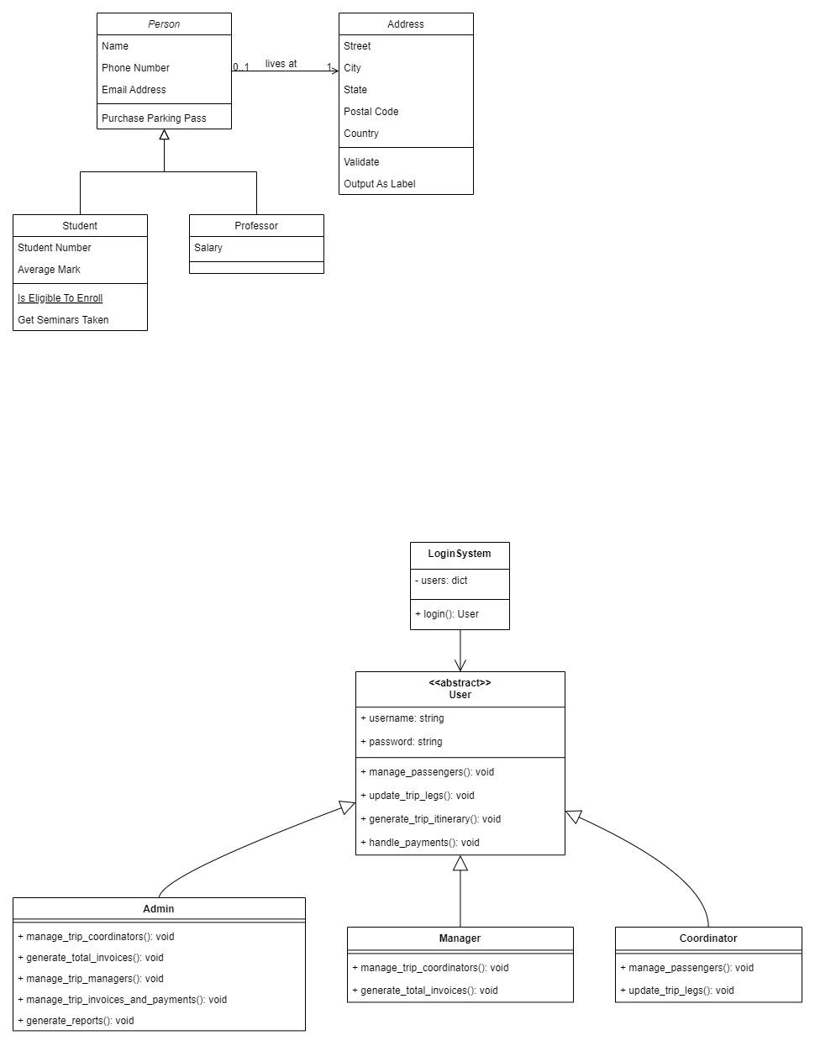
CLASS DIAGRAM
Notes:
This diagram is very important when there is work in the code with the classes and methods. This diagram shows all the classes with their respective attributes and information displays all the classes and allows interaction between them. After seeing these classes the user will understand how the internal system is going to work(Tiwari, R.G., Srivastava, A.P, LTE, 2021).
This class diagram shows all the 5 main classes with the respective attributes and shows all the relations between them. This class diagram helps to apply Object-oriented concepts because in object-oriented programming all the work revolves around these classes.

Slide 7
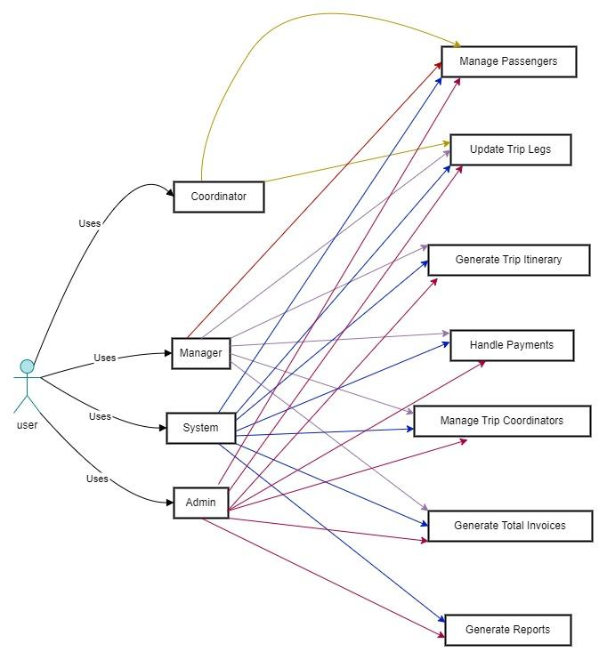
USE CASE DIAGRAM
Notes:
This use-case diagram shows all the interactions between actors which are external end users who use the application and interact with the specific software or web application. This diagram shows all the possible workflow that happened between actors and the system. All the tasks are displayed in the use-case shapes and all the interactions between both are displayed with the help of a use-case diagram.
This is the use-case diagram for the travel management system. In this diagram there is an actor named used. First, visit the management system and add their login credential whether he/she is a manager, admin, or anything else can see their information and manage all the related tasks. All the relations between use cases and actors are displayed with arrows and all arrows are a different color for the reader. Now the reader can read every relation without any issues.

Slide 8
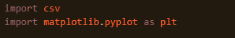
CODE EXPLANATION:
Choice of Programming Language
Utilization of Object-Oriented Programming (OOP)
Code Instruction Breakdown
Foundational OOP Principles
Clarity in Instructions
Expertise in Python
Readability and Scalability
Notes:
In this section of the report there is defined all the code of the travel management system. This management system as discussed above developed with the help of python language. The whole code of the management system is based on object oriented programming. Lets see each of the code instructions for better understanding of the code.
These are the first instructions of the code, in these instructions importing some external libraries to work with, these libraries include csv for working with csv files and the next library is matplotlib, the matplotlib is one of the most famous libraries of python (Lemenkova, P., 2020.). With the help of this matplotlib can create multiple graphs and different shapes for better understanding of the work
This is the first class of the code named USER, this class is used for storing and manipulating the user information including user email and user password (Nezdoyminov, S., Bedradina, G.,LTE, 2020). This information is necessary for enabling the security of the system and also for various other functions.

Slide 9
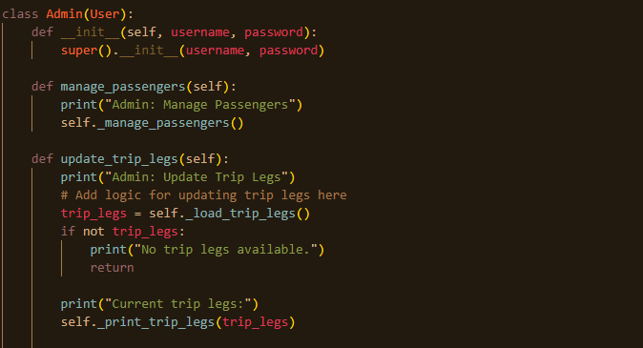
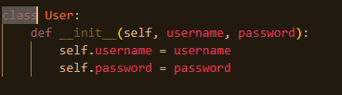
Notes:
This is the first class of the code named USER, this class is used for storing and manipulating the user information including user email and user password (Nezdoyminov, S., Bedradina, G.,LTE, 2020). This information is necessary for enabling the security of the system and also for various other functions.
This is the admin class with their functions, the admin class allows the user to first add password and username for access then if the user adds correct information then the user can perform various tasks. Like in this code snippet the function is manage_passengers and update_trip_logs the admin handles all these functions

Slide 10
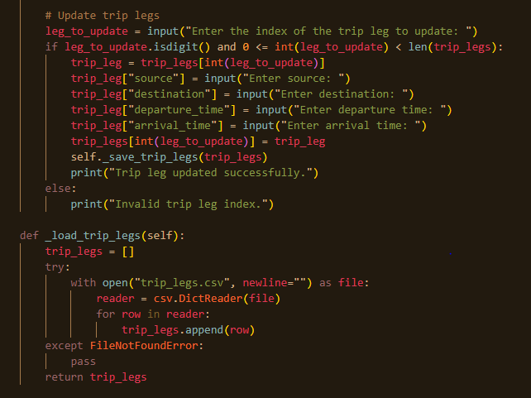
Notes:
This is the next function of the admin class including a function related to legs. This function took some input values from the user and then on the basis of input store information. And last there is a function to load_trip_legs with some expectation handling to catch the errors to avoid program termination.

Slide 11
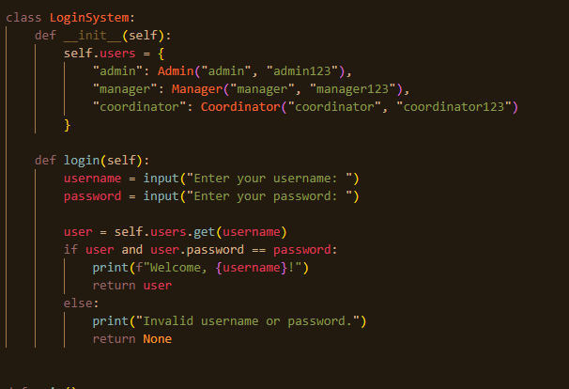
Notes:
Now this is the last class login system, in this login system class first all the login information is stored without this information the user can’t access the class and can; perform any operation to the class. Then after the information there are input instructions which take input from the user and match the user input with the stored usernames and passwords. If username and password are matched and corrected then the user can enter the management system and can perform all the related tasks. Like if a user enters username and password for admin, the user can perform admin’s related tasks same for other functions for manager and coordinator as well.

Slide 12
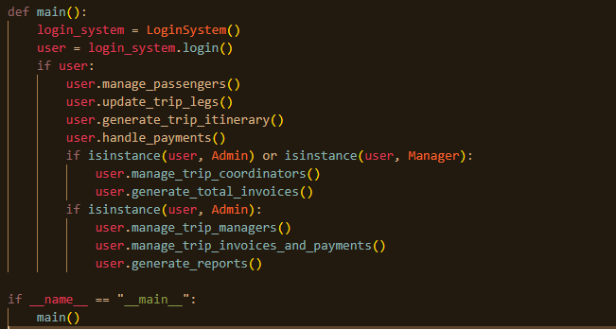
Notes:
Last there is a main function, the main function is also known as the backbone of the whole management system. Because without this function the developer or programmer can't run the management system. In this main function, the first login system class is called for getting information from the user, whether the user is admin, coordinator, manager or someone else who tried to run the code, after successfully authentication and security the user can perform all the tasks which are written in the code

Slide 13
CONCLUSION
Project Overview:
Our goal is to establish an all-encompassing digital platform that streamlines the management of every aspect of a travel agency's operations. This system will seamlessly handle passenger information and facilitate all necessary tasks.
Actors and Operations:
Within the system, three important roles include Administrator, Manager, and Coordinator. To effectively handle data, each of these roles has access to CRUD operations (Create, Read, Update, Delete), allowing them to manage data as needed.
Project Initiation:
With Solent University's support, this project seeks to immerse students in practical management system development, equipping them with valuable skills for the field.
Practical Implementation
Through the project, students can use their classroom knowledge in real-world situations and gain a deeper understanding of how such systems work in practice.
Python Implementation:
Python is predominantly employed as the main programming language due to its user-friendly nature and adaptability, rendering it appropriate for handling intricate systems.
Notes:
In this assessment the project is related to developing a system which can handle all the information of the travel agency and also can say it is a digital travel agency which handles all the passengers information, their data and multiple other tasks. This code defines all the necessary information which are important for the management system to be implemented. First there is admin class, then manager, then coordinator. These are the main actors of the class and for all these actors the create, delete, update and last view these crud operations are implemented. To make it easier for the customer, the university of Solent gave this project. To work with the real world mechanism and understand the logic behind these types of comprehensive management systems. Also in this report there are some UML diagrams which help users to understand the internal logic of the code. After reading this comprehensive report the reader can easily understand the travel management system which are build on the python language.

